Slide 1
SOLID

Slide 2
Intro
Donatas Kukta
Kazimieras Slivka
TransUnion
These slides are based on https://github.com/Almantask/CSharp-From-Zero-To-Hero/wiki/Summary#chapter-5-solid

Slide 3
What does SOLID stand for?
Single-responsibility: One reason to change
Open–closed: Open for extension, closed for modification
Liskov substitution: Use derived classes without knowing it
Interface segregation: Fine grained client-specific interfaces
Dependency inversion: Depend on abstractions, not concretions

Slide 4
Why SOLID is important?
Best practices to follow
Avoid complexity headache
Better code quality:
Improved readability
Better flexibility
Lower maintainability overhead
Applicable for software in general, not just source code
It is industry-standard and common question in interviews

Slide 5
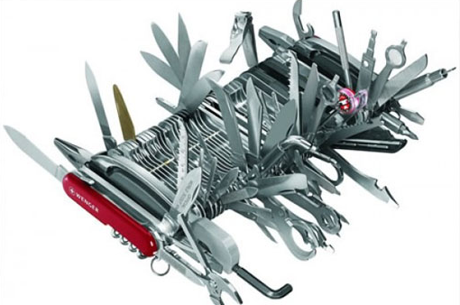
Single Responsibility principle
A function, class or a module should have a single reason to change.
Just Because You Can, Doesn’t Mean You Should!

Slide 6
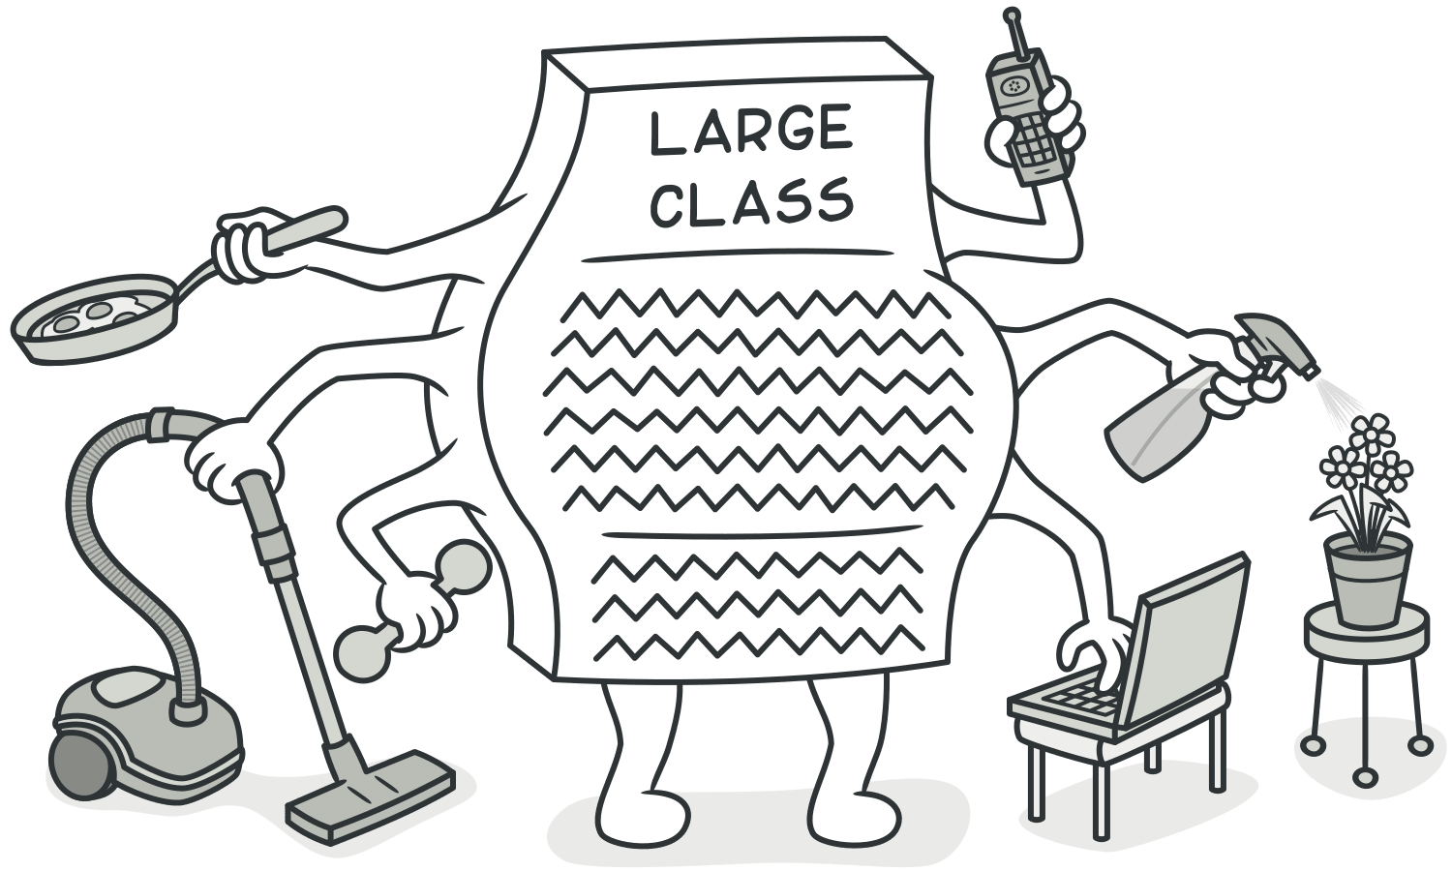
Single Responsibility principle
The God Class
Obvious flow of behavior
Structure is easy to understand
It’s easy to insert changes
Illusion vs reality
Nobody understands how it works
Everyone is afraid to change existing code
Everyone just stich new code to the class
Tech debt keeps growing

Slide 7
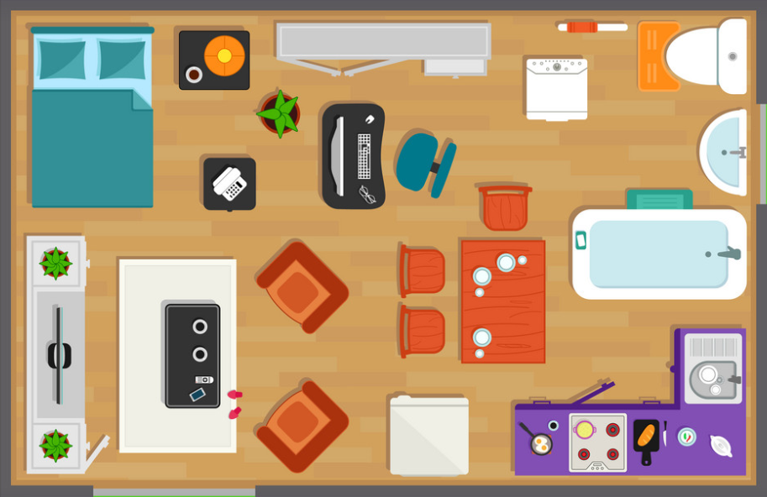
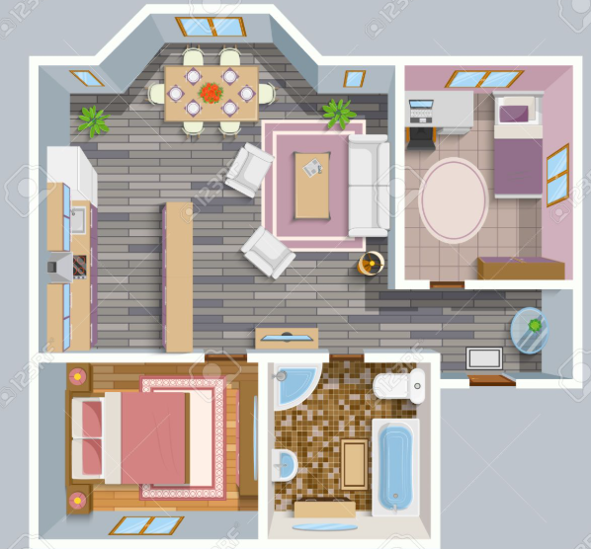
Single Responsibility principle. Examples
Bad
Good

Slide 8
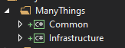
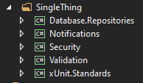
Single Responsibility principle. Examples
Bad
Good
Unknown, abstract contents
Semantical use (common things, third party things)
Question: what about common infrastructure?
Clear contents
Logical use (by project purpose)
No questions

Slide 9
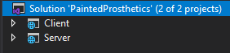
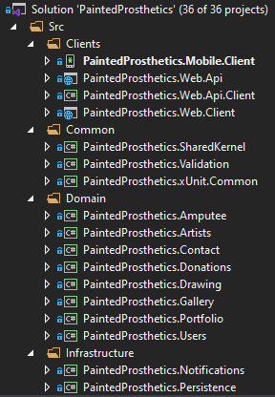
Single Responsibility principle. Examples
Bad
Good
For long term projects, it’s worth tackling complexity by splitting different system concerns into subsystems
Developers should strive to minimize the things we need to care about at once.

Slide 10
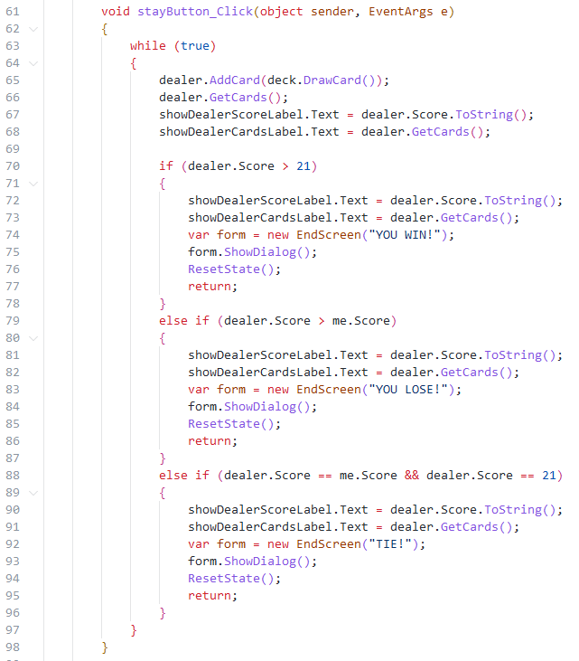
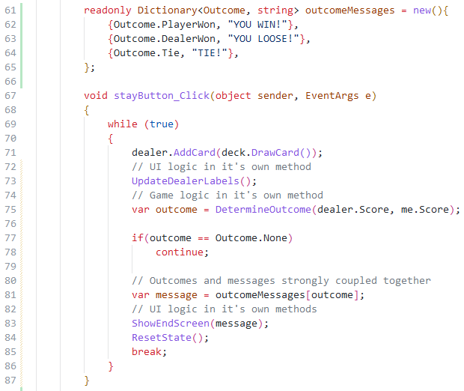
Bad
Better

Slide 11

Open-Closed principle
Software entities (classes, modules, functions, etc.) should be open for extension, but closed for modification.
Lights can be attached without disassembling the engine

Slide 12
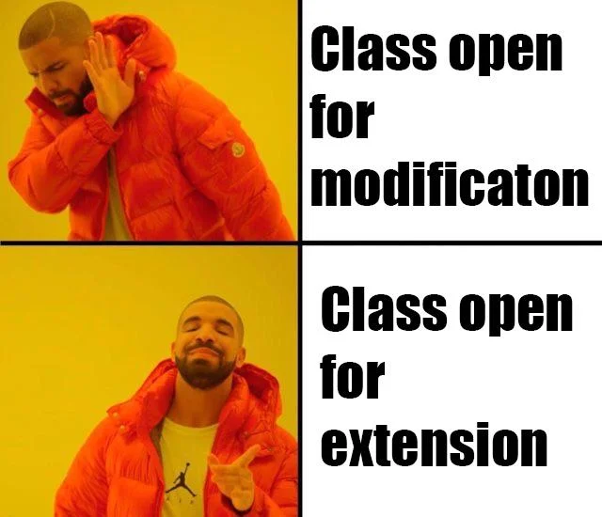
Open-Closed principle
Less changes in existing code
Less chances of breaking anything with new functionality
Easier to find different functionality
New changes has isolated complexity (no accumulated complexity)

Slide 13
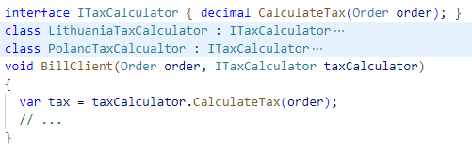
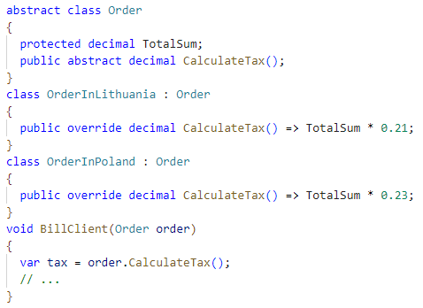
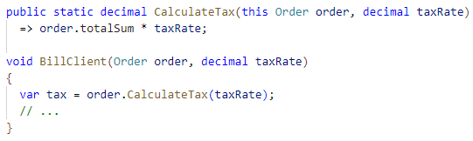
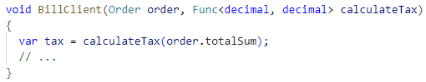
Open-Closed principle
2
How to add functionality without changing existing code?
Accepting functions as parameters
Using Extension Methods
Using Inheritance
Using Generics
Using Composition
3
1
4

Slide 14
Open-Closed principle: Composition vs Inheritance
Inheritance
Strongly couples Parent and Child
New behavior is implemented in Child
Child is stuck forever with one Parent
Should not be used as a mean to reuse code
Should be used as a mean to create logical hierarchies
Deep inheritance (2+ levels) increases complexity
Usually try to prefer composition over Inheritance ☺
Composition
Classes refer to nested objects instead of inheriting them
Class can depend on multiple other objects
Should be used as a mean to reuse code
Loosely coupled objects gives better flexibility
Easier to write unit tests

Slide 15
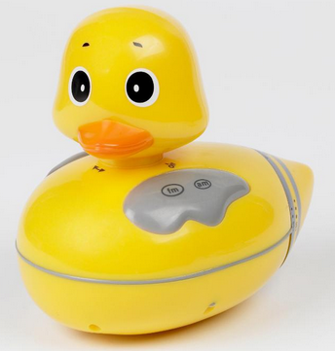
Liskov Substitution principle
Objects of a superclass shall be replaceable with objects of its subclasses without breaking the application.
TLDR; Use derived classes without knowing it.
It looks like a duck, quacks like a duck, but it needs batteries!
You probably have the wrong abstraction.

Slide 16
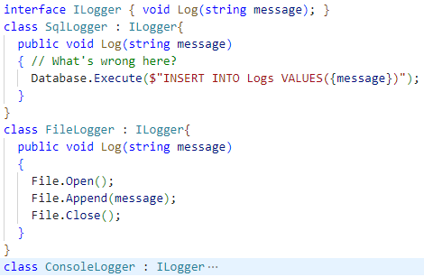
Liskov Substitution principle
Any class that is the child of a parent class should be usable in place of its parent without any unexpected behavior
Subtyping: implementing a class which follows requirements specified by an interface.
Inheritance: implementing a Child class that specializes Parent class to a particular use, by reusing it’s behavior and possibly overriding parts of it.
Behavior reuse (or override) should be easy to justify
Good for enforcing business logic, creating real world relations
Allows creating restrictions that must be followed
What do you think about the example on the right in terms for enforcing business logic?
Use derived classes without knowing it.

Slide 17
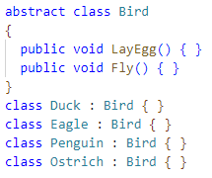
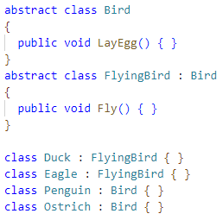
Liskov Substitution principle
Resembles real-life relation (they are all Birds)
Gives restrictions that are followed (Lay an Egg and Fly)
But what happens when Penguin or Ostrich tries to Fly?
Parent and Child classes are not always interchangeable.
Resembles real-life relation (they are all Birds)
Gives restriction that are followed (all can Lay an Egg and some can Fly)
Parent and Child classes are always interchangeable.
Be cautious about growing inheritance depth.

Slide 18

Interface Segregation principle
Fine-grained client-specific interfaces.
or
Clients should not be forced to depend on interfaces they don't use.
There is no combined power & water connector

Slide 19
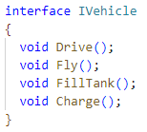
Interface Segregation principle
Avoid interface pollution
A single interface for everything is too vague and different implementations or clients might not use all that it provides
How many unrelated responsibilities exist in this interface?
What can we expect from the IVehicle?
What happens to the consumer when new methods are added?

Slide 20
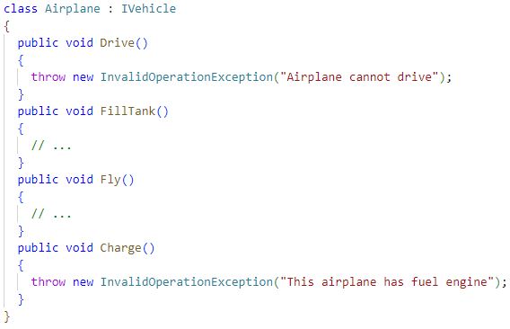
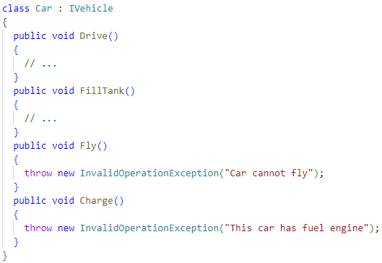
Interface Segregation principle: the problem

Slide 21
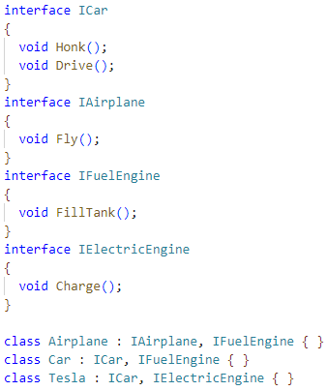
Interface Segregation principle: the solution
Interfaces are split into logically separated parts
Clients are allowed to use only what’s needed for them
Better distinction of responsibilities
Easier to compose multiple interfaces together
Flexible object usability

Slide 22

Dependency Inversion Principle
Depend on abstractions, not concrete implementations.
Excavator design doesn’t depend on attachments

Slide 23
The idea
High level modules should not depend on low level modules. Both should depend on abstractions.
Abstractions should not depend on details. Details should depend on abstractions.
Avoid hardcoding dependencies
Use abstractions that your domain needs

Slide 24

DIP - Maintainability
With DIP, we achieve simplicity (isolate the details)
We get a living documentation (a contract that tells what a class can do)
We don’t marry any framework-specific implementation (or abstraction), so if we need a change, we can do it without rewriting

Slide 25

DIP - Testability
It’s easy to mock abstractions (so we can write unit tests for whatever consumes them)
If we weren’t depending on abstractions, we would need to create fake doubles in order to be able to test

Slide 26

DIP - Reusability
Components (especially lower level) can be swapped
We can swap system as a whole or a part of it

Slide 27
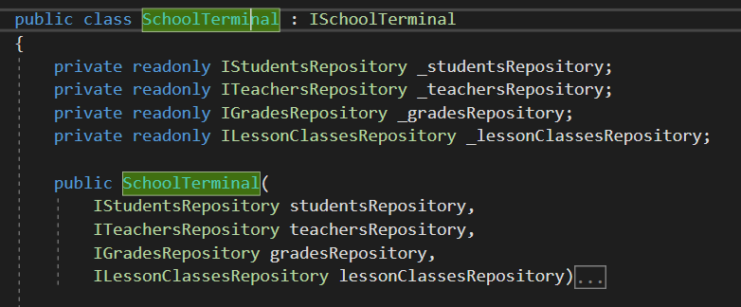
Constructor injection
The most common way of achieving dependency inversion
Expose abstractions in ctor

Slide 28
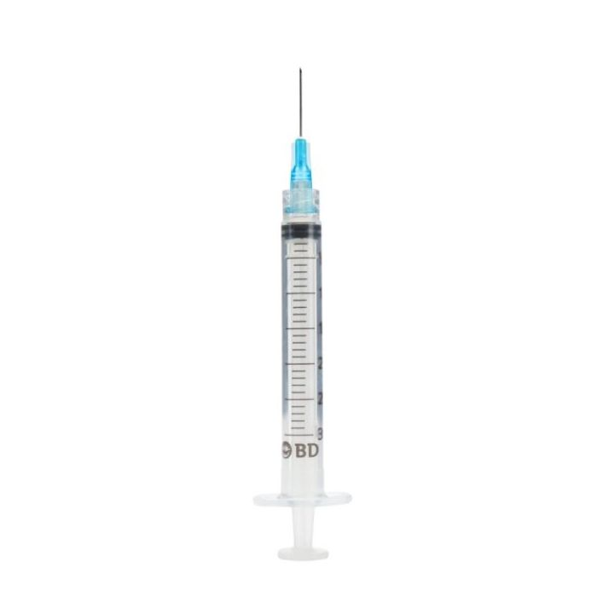
What are the ways of injecting external dependencies?

Slide 29
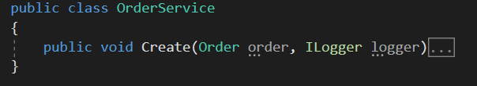
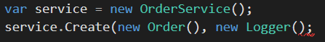
Method injection
Expose abstractions in a method
Way less popular than ctor injection

Slide 30
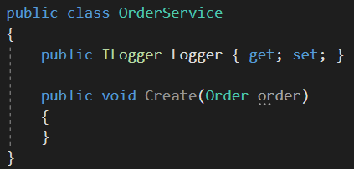
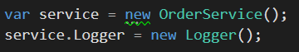
Property injection
Expose abstraction in a property
The least popular

Slide 31
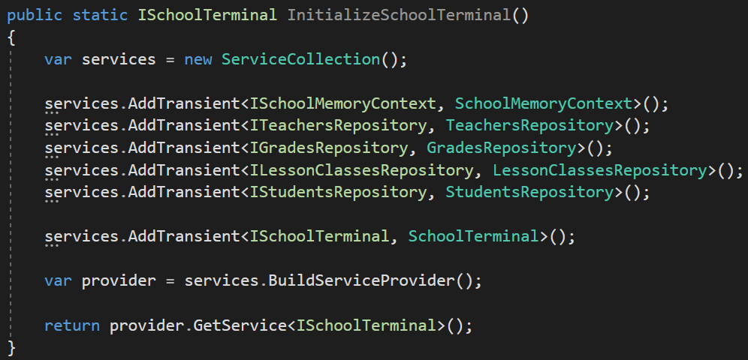
Inversion Of Control
In a single place
At the startup of your application
Create once (recommended)

Slide 32
Let’s get our terminology straight
Dependency inversion
Last principle of SRP
Depend on abstractions not implementations!
Dependency injection
A pattern that implements the principle
A way of exposing dependencies through ctor, method or a property
Inversion of control
A way of managing dependencies in one place
It’s how dependencies are configured in Startup

Slide 34
Tips to make your code SOLID!
Try to find a balance between grouping and separating code/logic
Prefer composition over inheritance
Avoid long methods, classes and interfaces
Use interfaces! Ensure they have clear reusable purpose
Think about what needs to be done to extend the code in the future
Assume that someone with less experience is reading your code
Avoid hardcoding

Slide 35
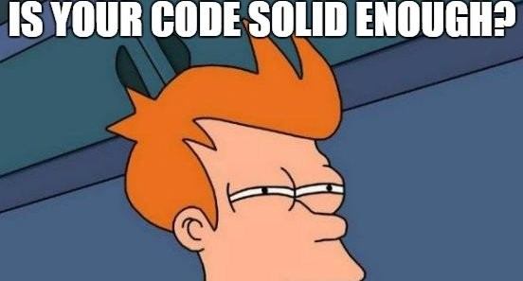
Workshop time!

Slide 36
Useful links
https://github.com/Almantask/CSharp-From-Zero-To-Hero/

